Slide 1
Data Mining
Practical Machine Learning Tools and Techniques
Slides for Chapter 1 of Data Mining by I. H. Witten, E. Frank and
M. A. Hall

Slide 2
What’s it all about?
Data vs information
Data mining and machine learning
Structural descriptions
  Rules: classification and association
  Decision trees
Datasets
  Weather, contact lens, CPU performance, labor negotiation data, soybean classification
Fielded applications
  Ranking web pages, loan applications, screening images, load forecasting, machine fault diagnosis, market basket analysis
Generalization as search
Data mining and ethics

Slide 3
Data vs. information
Society produces huge amounts of data
  Sources: business, science, medicine, economics, geography, environment, sports, …
Potentially valuable resource
Raw data is useless: need techniques to automatically extract information from it
  Data: recorded facts
  Information: patterns underlying the data

Slide 4
Information is crucial
Example 1: in vitro fertilization
  Given: embryos described by 60 features
  Problem: selection of embryos that will survive
  Data: historical records of embryos and outcome
Example 2: cow culling
  Given: cows described by 700 features
  Problem: selection of cows that should be culled
  Data: historical records and farmers’ decisions

Slide 5
Data mining
Extracting
  implicit,
  previously unknown,
  potentially useful
information from data
Needed: programs that detect patterns and regularities in the data
Strong patterns ⇒ good predictions
  Problem 1: most patterns are not interesting
  Problem 2: patterns may be inexact (or spurious)
  Problem 3: data may be garbled or missing

Slide 6
Machine learning techniques
Algorithms for acquiring structural descriptions from examples
Structural descriptions represent patterns explicitly
  Can be used to predict outcome in new situation
  Can be used to understand and explain how prediction is derived
  (may be even more important)
Methods originate from artificial intelligence, statistics, and research on databases

Slide 7

Structural descriptions
Example: if-then rules
If tear production rate = reduced
then recommendation = none
Otherwise, if age = young and astigmatic = no
then recommendation = soft
Age
Spectacle prescription
Astigmatism
Tear production rate
Recommended lenses
Young
Myope
No
Reduced
None
Young
Hypermetrope
No
Normal
Soft
Pre-presbyopic
Hypermetrope
No
Reduced
None
Presbyopic
Myope
Yes
Normal
Hard
…
…
…
…
…

Slide 8
Can machines really learn?
Definitions of “learning” from dictionary:
To get knowledge of by study,
experience, or being taught
To become aware by information or
from observation
To commit to memory
To be informed of, ascertain; to receive instruction
Difficult to measure
Trivial for computers
Operational definition:
Things learn when they change their behavior in a way that makes them perform better in the future.
Does a slipper learn?
Does learning imply intention?

Slide 9
The weather problem
Conditions for playing a certain game
Outlook
Temperature
Humidity
Windy
Play
Sunny
Hot
High
False
No
Sunny
Hot
High
True
No
Overcast
Hot
High
False
Yes
Rainy
Mild
Normal
False
Yes
…
…
…
…
…
If outlook = sunny and humidity = high then play = no
If outlook = rainy and windy = true then play = no
If outlook = overcast then play = yes
If humidity = normal then play = yes
If none of the above then play = yes

Slide 10


Ross Quinlan
Machine learning researcher from 1970’s
University of Sydney, Australia
1986 “Induction of decision trees” ML Journal
1993 C4.5: Programs for machine learning. Morgan Kaufmann
199? Started

Slide 11
Classification vs. association rules
Classification rule:
predicts value of a given attribute (the classification of an example)
Association rule:
predicts value of arbitrary attribute (or combination)
If outlook = sunny and humidity = high
then play = no
If temperature = cool then humidity = normal
If humidity = normal and windy = false
then play = yes
If outlook = sunny and play = no
then humidity = high
If windy = false and play = no
then outlook = sunny and humidity = high

Slide 12
Weather data with mixed attributes
Some attributes have numeric values
Outlook
Temperature
Humidity
Windy
Play
Sunny
85
85
False
No
Sunny
80
90
True
No
Overcast
83
86
False
Yes
Rainy
75
80
False
Yes
…
…
…
…
…
If outlook = sunny and humidity > 83 then play = no
If outlook = rainy and windy = true then play = no
If outlook = overcast then play = yes
If humidity < 85 then play = yes
If none of the above then play = yes

Slide 13
The contact lenses data
Age
Spectacle prescription
Astigmatism
Tear production rate
Recommended lenses
Young
Myope
No
Reduced
None
Young
Myope
No
Normal
Soft
Young
Myope
Yes
Reduced
None
Young
Myope
Yes
Normal
Hard
Young
Hypermetrope
No
Reduced
None
Young
Hypermetrope
No
Normal
Soft
Young
Hypermetrope
Yes
Reduced
None
Young
Hypermetrope
Yes
Normal
hard
Pre-presbyopic
Myope
No
Reduced
None
Pre-presbyopic
Myope
No
Normal
Soft
Pre-presbyopic
Myope
Yes
Reduced
None
Pre-presbyopic
Myope
Yes
Normal
Hard
Pre-presbyopic
Hypermetrope
No
Reduced
None
Pre-presbyopic
Hypermetrope
No
Normal
Soft
Pre-presbyopic
Hypermetrope
Yes
Reduced
None
Pre-presbyopic
Hypermetrope
Yes
Normal
None
Presbyopic
Myope
No
Reduced
None
Presbyopic
Myope
No
Normal
None
Presbyopic
Myope
Yes
Reduced
None
Presbyopic
Myope
Yes
Normal
Hard
Presbyopic
Hypermetrope
No
Reduced
None
Presbyopic
Hypermetrope
No
Normal
Soft
Presbyopic
Hypermetrope
Yes
Reduced
None
Presbyopic
Hypermetrope
Yes
Normal
None

Slide 14
A complete and correct rule set
If tear production rate = reduced then recommendation = none
If age = young and astigmatic = no
and tear production rate = normal then recommendation = soft
If age = pre-presbyopic and astigmatic = no
and tear production rate = normal then recommendation = soft
If age = presbyopic and spectacle prescription = myope
and astigmatic = no then recommendation = none
If spectacle prescription = hypermetrope and astigmatic = no
and tear production rate = normal then recommendation = soft
If spectacle prescription = myope and astigmatic = yes
and tear production rate = normal then recommendation = hard
If age young and astigmatic = yes
and tear production rate = normal then recommendation = hard
If age = pre-presbyopic
and spectacle prescription = hypermetrope
and astigmatic = yes then recommendation = none
If age = presbyopic and spectacle prescription = hypermetrope
and astigmatic = yes then recommendation = none

Slide 15
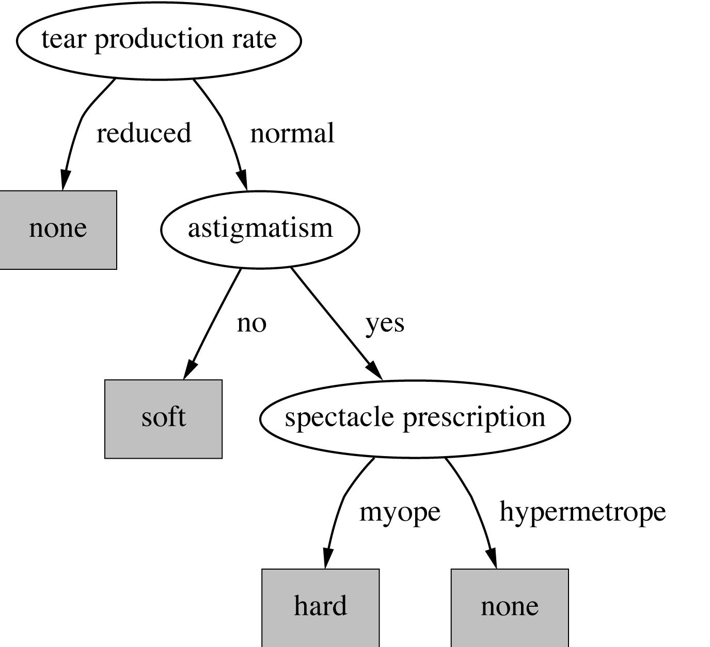
A decision tree for this problem

Slide 16

Classifying iris flowers
Sepal length
Sepal width
Petal length
Petal width
Type
1
5.1
3.5
1.4
0.2
Iris setosa
2
4.9
3.0
1.4
0.2
Iris setosa
…
51
7.0
3.2
4.7
1.4
Iris versicolor
52
6.4
3.2
4.5
1.5
Iris versicolor
…
101
6.3
3.3
6.0
2.5
Iris virginica
102
5.8
2.7
5.1
1.9
Iris virginica
…
If petal length < 2.45 then Iris setosa
If sepal width < 2.10 then Iris versicolor
...

Slide 17
Predicting CPU performance
Example: 209 different computer configurations
Linear regression function
Cycle time (ns)
Main memory (Kb)
Cache (Kb)
Channels
Performance
MYCT
MMIN
MMAX
CACH
CHMIN
CHMAX
PRP
1
125
256
6000
256
16
128
198
2
29
8000
32000
32
8
32
269
…
208
480
512
8000
32
0
0
67
209
480
1000
4000
0
0
0
45
PRP = -55.9 + 0.0489 MYCT + 0.0153 MMIN + 0.0056 MMAX
+ 0.6410 CACH - 0.2700 CHMIN + 1.480 CHMAX

Slide 18
Data from labor negotiations
Attribute
Type
1
2
3
…
40
Duration
(Number of years)
1
2
3
2
Wage increase first year
Percentage
2%
4%
4.3%
4.5
Wage increase second year
Percentage
?
5%
4.4%
4.0
Wage increase third year
Percentage
?
?
?
?
Cost of living adjustment
{none,tcf,tc}
none
tcf
?
none
Working hours per week
(Number of hours)
28
35
38
40
Pension
{none,ret-allw, empl-cntr}
none
?
?
?
Standby pay
Percentage
?
13%
?
?
Shift-work supplement
Percentage
?
5%
4%
4
Education allowance
{yes,no}
yes
?
?
?
Statutory holidays
(Number of days)
11
15
12
12
Vacation
{below-avg,avg,gen}
avg
gen
gen
avg
Long-term disability assistance
{yes,no}
no
?
?
yes
Dental plan contribution
{none,half,full}
none
?
full
full
Bereavement assistance
{yes,no}
no
?
?
yes
Health plan contribution
{none,half,full}
none
?
full
half
Acceptability of contract
{good,bad}
bad
good
good
good

Slide 19
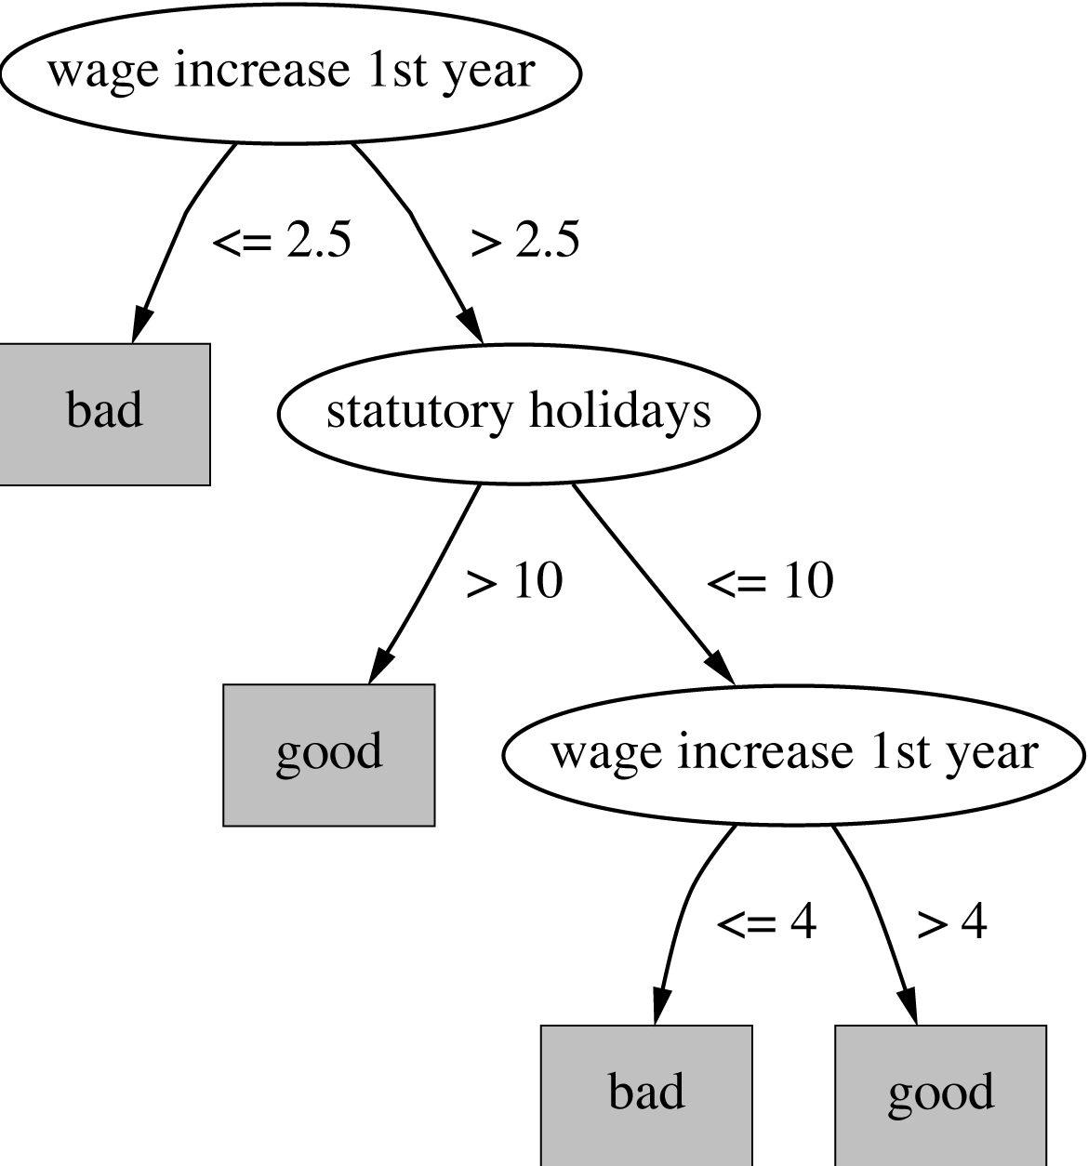
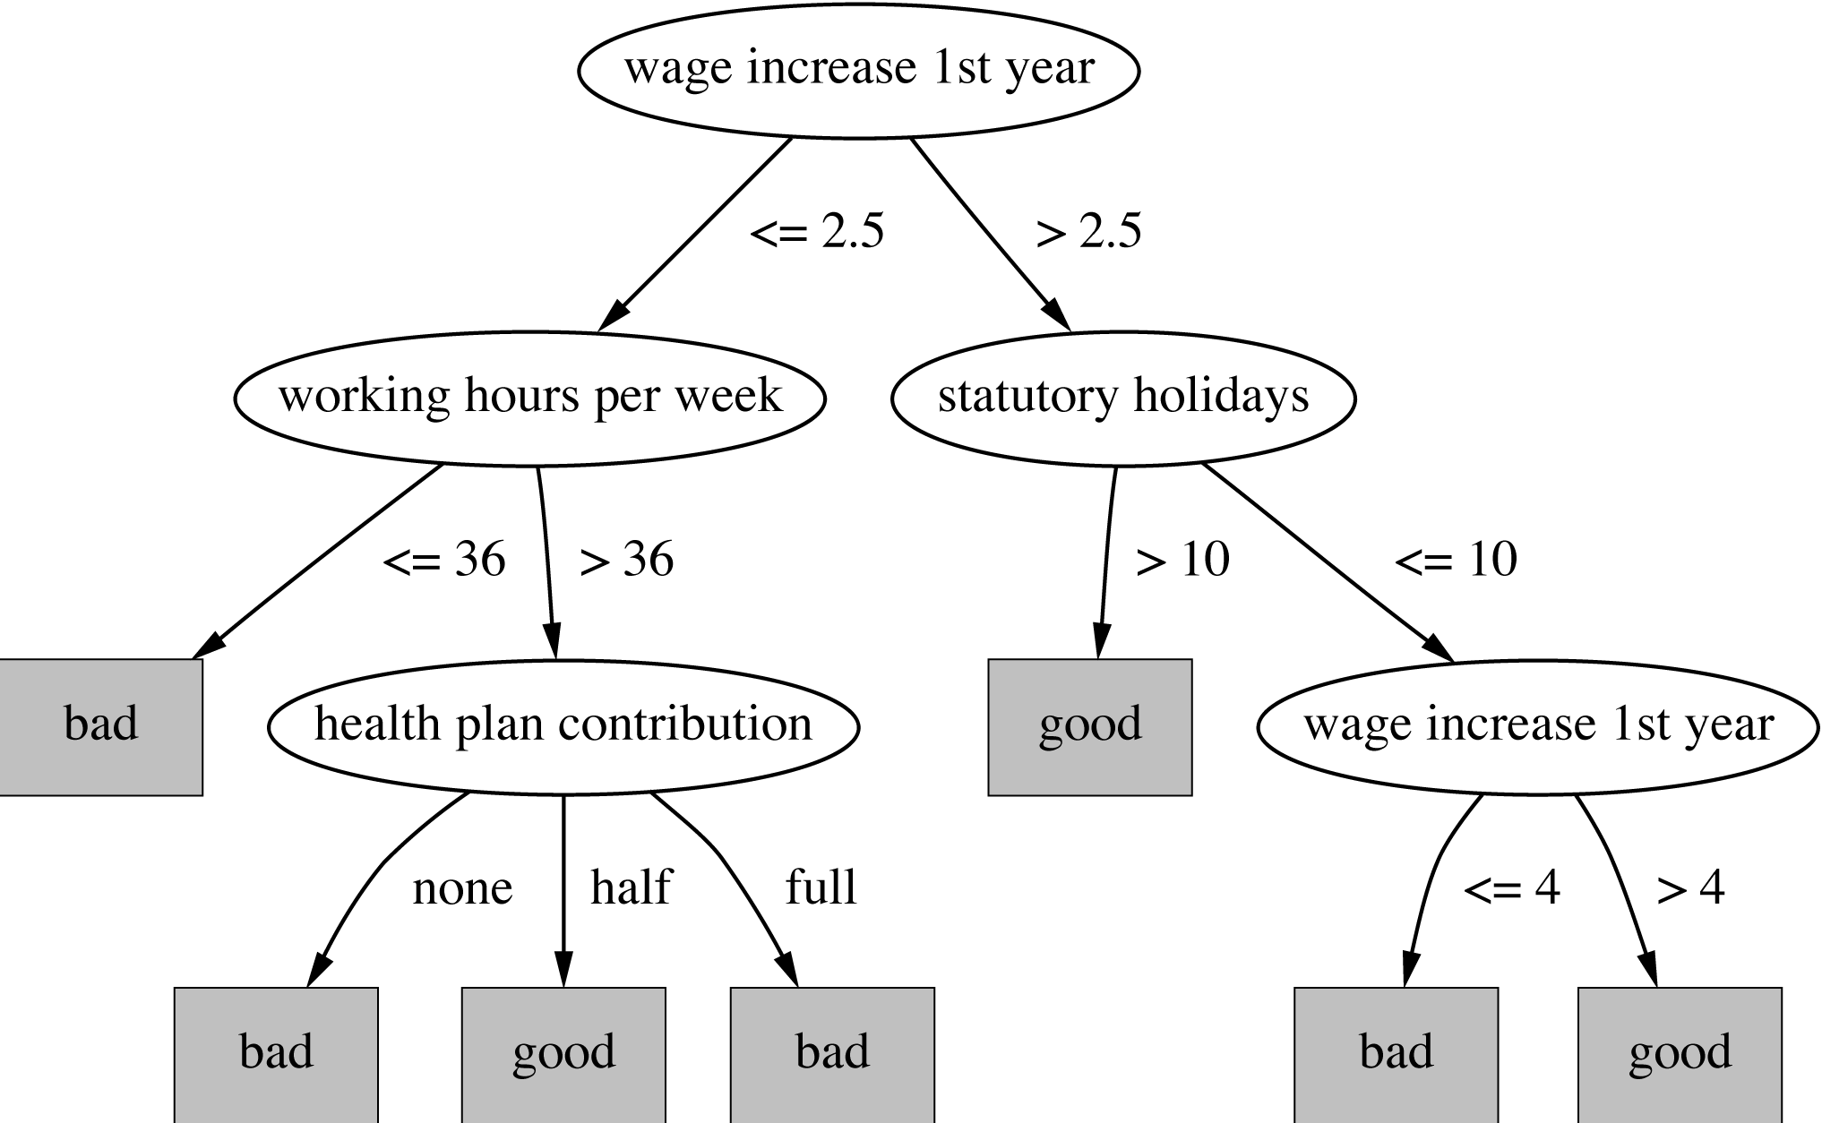
Decision trees for the labor data

Slide 20
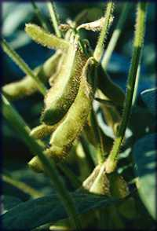
Soybean classification
Attribute
Number of values
Sample value
Environment
Time of occurrence
7
July
Precipitation
3
Above normal
…
Seed
Condition
2
Normal
Mold growth
2
Absent
…
Fruit
Condition of fruit pods
4
Normal
Fruit spots
5
?
Leaf
Condition
2
Abnormal
Leaf spot size
3
?
…
Stem
Condition
2
Abnormal
Stem lodging
2
Yes
…
Root
Condition
3
Normal
Diagnosis
19
Diaporthe stem canker

Slide 21
The role of domain knowledge
If leaf condition is normal
and stem condition is abnormal
and stem cankers is below soil line
and canker lesion color is brown
then
diagnosis is rhizoctonia root rot
If leaf malformation is absent
and stem condition is abnormal
and stem cankers is below soil line
and canker lesion color is brown
then
diagnosis is rhizoctonia root rot
But in this domain, “leaf condition is normal” implies
“leaf malformation is absent”!

Slide 22
Fielded applications
The result of learning—or the learning method itself—is deployed in practical applications
  Processing loan applications
  Screening images for oil slicks
  Electricity supply forecasting
  Diagnosis of machine faults
  Marketing and sales
  Separating crude oil and natural gas
  Reducing banding in rotogravure printing
  Finding appropriate technicians for telephone faults
  Scientific applications: biology, astronomy, chemistry
  Automatic selection of TV programs
  Monitoring intensive care patients

Slide 23
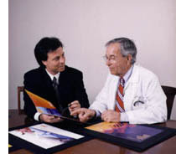
Processing loan applications (American Express)
Given: questionnaire with
financial and personal information
Question: should money be lent?
Simple statistical method covers 90% of cases
Borderline cases referred to loan officers
But: 50% of accepted borderline cases defaulted!
Solution: reject all borderline cases?
  No! Borderline cases are most active customers

Slide 24
Enter machine learning
1000 training examples of borderline cases
20 attributes:
  age
  years with current employer
  years at current address
  years with the bank
  other credit cards possessed,…
Learned rules: correct on 70% of cases
  human experts only 50%
Rules could be used to explain decisions to customers

Slide 25
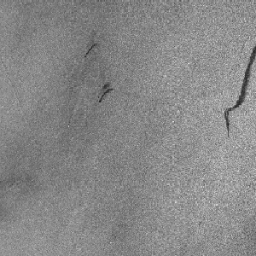
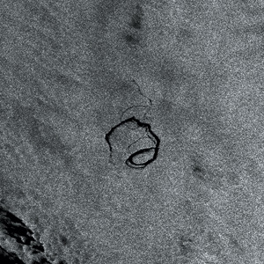
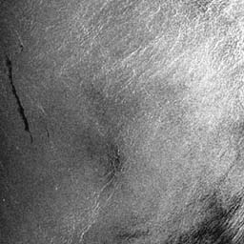
Screening images
Given: radar satellite images of coastal waters
Problem: detect oil slicks in those images
Oil slicks appear as dark regions with changing size and shape
Not easy: lookalike dark regions can be caused by weather conditions (e.g. high wind)
Expensive process requiring highly trained personnel

Slide 26
Enter machine learning
Extract dark regions from normalized image
Attributes:
  size of region
  shape, area
  intensity
  sharpness and jaggedness of boundaries
  proximity of other regions
  info about background
Constraints:
  Few training examples—oil slicks are rare!
  Unbalanced data: most dark regions aren’t slicks
  Regions from same image form a batch
  Requirement: adjustable false-alarm rate

Slide 27
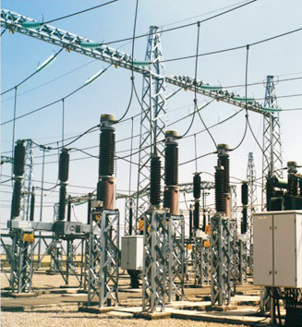
Load forecasting
Electricity supply companies
need forecast of future demand
for power
Forecasts of min/max load for each hour
⇒ significant savings
Given: manually constructed load model that assumes “normal” climatic conditions
Problem: adjust for weather conditions
Static model consist of:
  base load for the year
  load periodicity over the year
  effect of holidays

Slide 28
Enter machine learning
Prediction corrected using “most similar” days
Attributes:
  temperature
  humidity
  wind speed
  cloud cover readings
  plus difference between actual load and predicted load
Average difference among three “most similar” days added to static model
Linear regression coefficients form attribute weights in similarity function

Slide 29
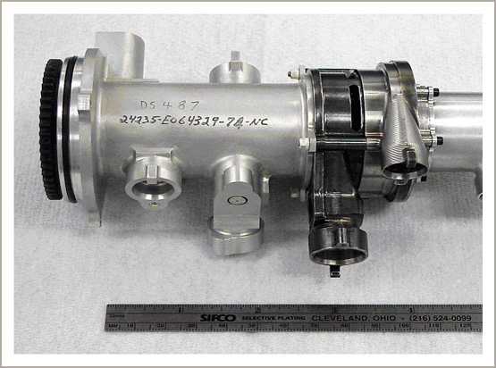
Diagnosis of machine faults
Diagnosis: classical domain
of expert systems
Given: Fourier analysis of vibrations measured at various points of a device’s mounting
Question: which fault is present?
Preventative maintenance of electromechanical motors and generators
Information very noisy
So far: diagnosis by expert/hand-crafted rules

Slide 30
Enter machine learning
Available: 600 faults with expert’s diagnosis
~300 unsatisfactory, rest used for training
Attributes augmented by intermediate concepts that embodied causal domain knowledge
Expert not satisfied with initial rules because they did not relate to his domain knowledge
Further background knowledge resulted in more complex rules that were satisfactory
Learned rules outperformed hand-crafted ones

Slide 31
Marketing and sales I
Companies precisely record massive amounts of marketing and sales data
Applications:
  Customer loyalty:
  identifying customers that are likely to defect by detecting changes in their behavior
  (e.g. banks/phone companies)
  Special offers:
  identifying profitable customers
  (e.g. reliable owners of credit cards that need extra money during the holiday season)

Slide 32
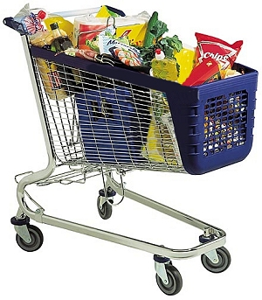
Marketing and sales II
Market basket analysis
  Association techniques find
  groups of items that tend to
  occur together in a
  transaction
  (used to analyze checkout data)
Historical analysis of purchasing patterns
Identifying prospective customers
  Focusing promotional mailouts
  (targeted campaigns are cheaper than mass-marketed ones)

Slide 33
Machine learning and statistics
Historical difference (grossly oversimplified):
  Statistics: testing hypotheses
  Machine learning: finding the right hypothesis
But: huge overlap
  Decision trees (C4.5 and CART)
  Nearest-neighbor methods
Today: perspectives have converged
  Most ML algorithms employ statistical techniques

Slide 34
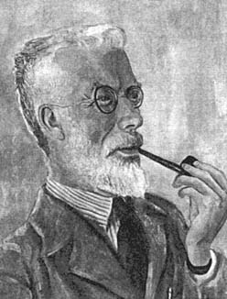
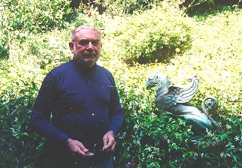
Statisticians
Sir Ronald Aylmer Fisher
Born: 17 Feb 1890 London, England
Died: 29 July 1962 Adelaide, Australia
Numerous distinguished contributions to developing the theory and application of statistics for making quantitative a vast field of biology
Leo Breiman
Developed decision trees
1984 Classification and Regression Trees. Wadsworth.

Slide 35
Generalization as search
Inductive learning: find a concept description that fits the data
Example: rule sets as description language
  Enormous, but finite, search space
Simple solution:
  enumerate the concept space
  eliminate descriptions that do not fit examples
  surviving descriptions contain target concept

Slide 36
Enumerating the concept space
Search space for weather problem
  4 x 4 x 3 x 3 x 2 = 288 possible combinations
  With 14 rules ⇒ 2.7x10³⁴ possible rule sets
Other practical problems:
  More than one description may survive
  No description may survive
    Language is unable to describe target concept
    or data contains noise
Another view of generalization as search:
hill-climbing in description space according to pre-specified matching criterion
  Most practical algorithms use heuristic search that cannot guarantee to find the optimum solution

Slide 37
Bias
Important decisions in learning systems:
  Concept description language
  Order in which the space is searched
  Way that overfitting to the particular training data is avoided
These form the “bias” of the search:
  Language bias
  Search bias
  Overfitting-avoidance bias

Slide 38
Language bias
Important question:
  is language universal
  or does it restrict what can be learned?
Universal language can express arbitrary subsets of examples
If language includes logical or (“disjunction”), it is universal
Example: rule sets
Domain knowledge can be used to exclude some concept descriptions a priori from the search

Slide 39
Search bias
Search heuristic
  “Greedy” search: performing the best single step
  “Beam search”: keeping several alternatives
  …
Direction of search
  General-to-specific
    E.g. specializing a rule by adding conditions
  Specific-to-general
    E.g. generalizing an individual instance into a rule

Slide 40
Overfitting-avoidance bias
Can be seen as a form of search bias
Modified evaluation criterion
  E.g. balancing simplicity and number of errors
Modified search strategy
  E.g. pruning (simplifying a description)
    Pre-pruning: stops at a simple description before search proceeds to an overly complex one
    Post-pruning: generates a complex description first and simplifies it afterwards

Slide 41

Data mining and ethics I
Ethical issues arise in
practical applications
Anonymizing data is difficult
  85% of Americans can be identified from just zip code, birth date and sex
Data mining often used to discriminate
  E.g. loan applications: using some information (e.g. sex, religion, race) is unethical
Ethical situation depends on application
  E.g. same information ok in medical application
Attributes may contain problematic information
  E.g. area code may correlate with race

Slide 42
Data mining and ethics II
Important questions:
  Who is permitted access to the data?
  For what purpose was the data collected?
  What kind of conclusions can be legitimately drawn from it?
Caveats must be attached to results
Purely statistical arguments are never sufficient!
Are resources put to good use?

